Slide 1

ABC Church System Designs
Taki Swanson

Slide 2
Agenda
System options for church
Floor-plan
Takeaways & suggestions

Slide 3

System Improvements Needs
Reporting
Communication
Record keeping
Filing

Slide 4
Option 1 – Add on to legacy system
Keep current database + simple tools
Scheduling
Shared Google Calendar
Set reoccurring events (rehearsals, ceremonies, etc)
Part-time work schedules
Communication & Reminders
Google voice/email
Live person answers phone if no one else does & lives church the messages.
Text message reminders & updates
Revenue tracking & reporting
Excel spreadsheets
Track offerings & pledges
Manual reports to HQ
Who manages
Hire contract developer
Train staff to manage system
Total Cost of Ownership(TCO)
Set up – 4k to 10k(1st year)
Monthly - $40 to $140
Implementation
4 to 8 weeks

Slide 5
Option 2 - Cloud based provider
Planning Center
Widely used church management software offering interconnected apps functioned as one unified system
Services
Worship scheduling
Team coordination
Event registration & reminders
Customized reports
Automated reminders
Phone message system
People
Member database
Title profiles
Check-Ins
Attendance(Physical or Virtual)
Children’s daycare/bible study
Volunteers schedule
Giving
Donations
Pledges & upcoming due dates
Tax information
Groups
Choir, bible study, volunteers, pastors, etc.
Announcements
Who manages
Vendor set up & maintenance
Staff training provided
Total Cost of Ownership(TCO)
Set up- $75 to $150
Monthly- $75 to $150
Yearly- $1000 to $2000
Implementation
6 to 12 weeks

Slide 6
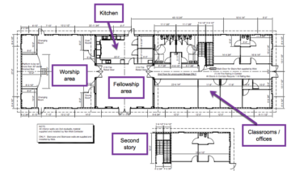
ABC Church Layout

Slide 7

Takeaways & Suggestions
Option 2 (Recommended)
Pros
Everything in one system
Automated tasks
Ease of use
Grows with the church
Smartphone compatible
Cons
Monthly cost
Training is required
Existing data needs to be moved to new system
Option 1
Pros
Low cost
Familiar system
Quick set up
Cons
Still requires manual work
Tools are not in one place
Harder to scale growth
Suggestions
Additional desktop & a laptop
Creating social media accounts for exposure
Referral program
At-the-door check-in system

Slide 8




Q & A

Slide 9

Thank you

